Slide 1

ML-2 PROJECT
BY
Aashish Pathak,
Ashish Alden Dsouza,
Rajat Kumar Sahu &
Santosh Susarla

Slide 2
Problem Statement
Using the Adult dataset (UCI Repository) we need to apply various classification modeling techniques thought to us and predict whether a person with the given conditions makes over 50K a year or not.

Slide 3
History
Extraction was done by Barry Becker from the 1994 Census database. A set of reasonably clean records was extracted using the following conditions: ((AAGE>16) && (AGI>100) && (AFNLWGT>1)&& (HRSWK>0))

Slide 4
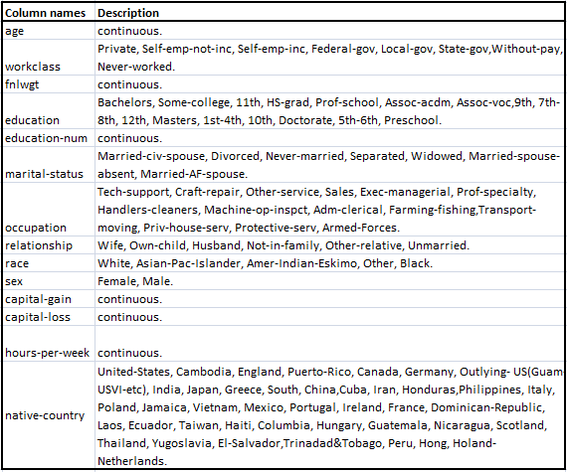
Dataset Description

Slide 5
Model Building Techniques Used
Logistic Regression
Naive Bayes
KNN
Decision Tree
Random Forest
Bagging
Boosting
Adaboost and XGboost ,
Gradient Boosting ,
Voting &
Stacking

Slide 6
Model Results

Slide 7
Contents
Problem statement
Literature Survey
Data variables / features description
Feature engineering and feature selection
Model building and evaluation - 1) decision tree 2) random forest 3) bagging 4) boosting -adaboost and xgboost , gradient boosting , voting and stacking
Results and discussion
Acknowledgement

